Slide 1
Group 5 Check-In
Maze Solving in Python

Slide 2
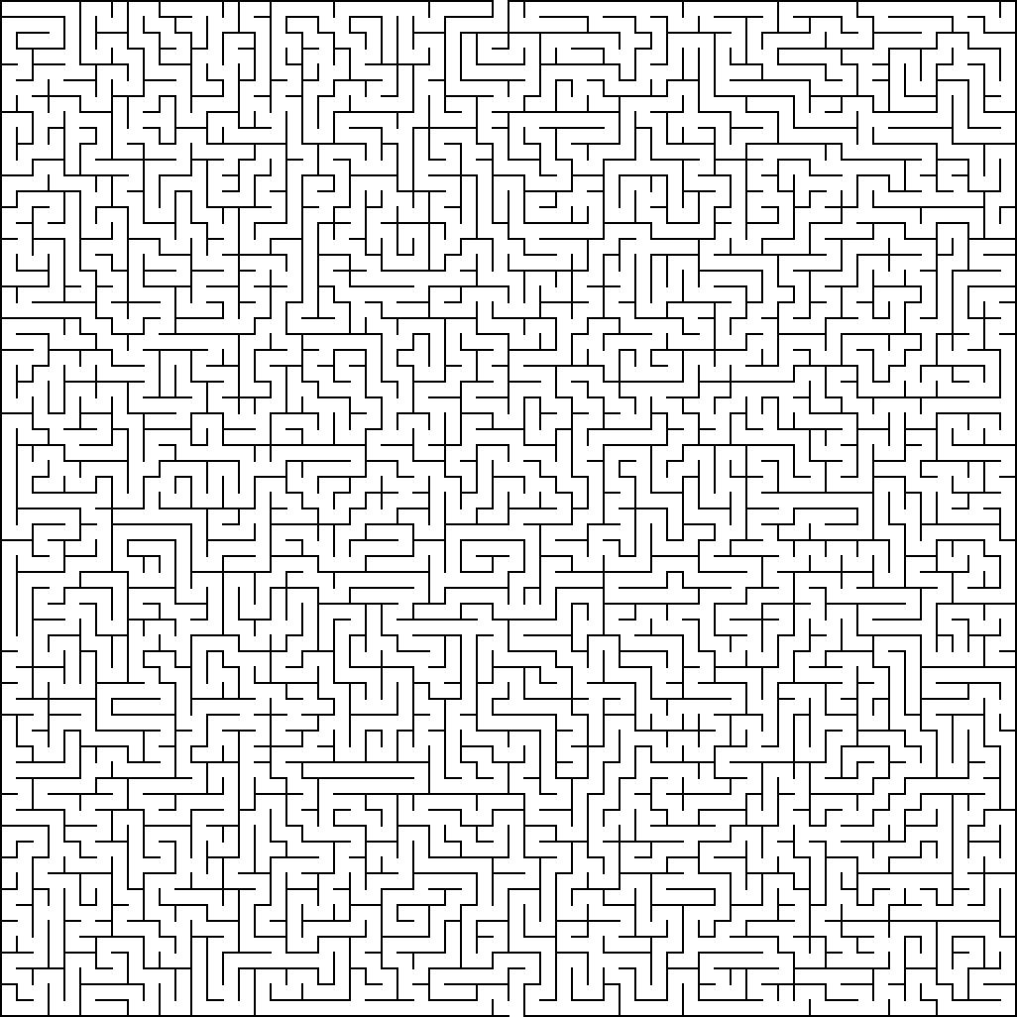
Loading MAZE_0 into a Python script
- We will solve this Maze by loading it into Python and having it generate the solution for us to view.

Slide 3
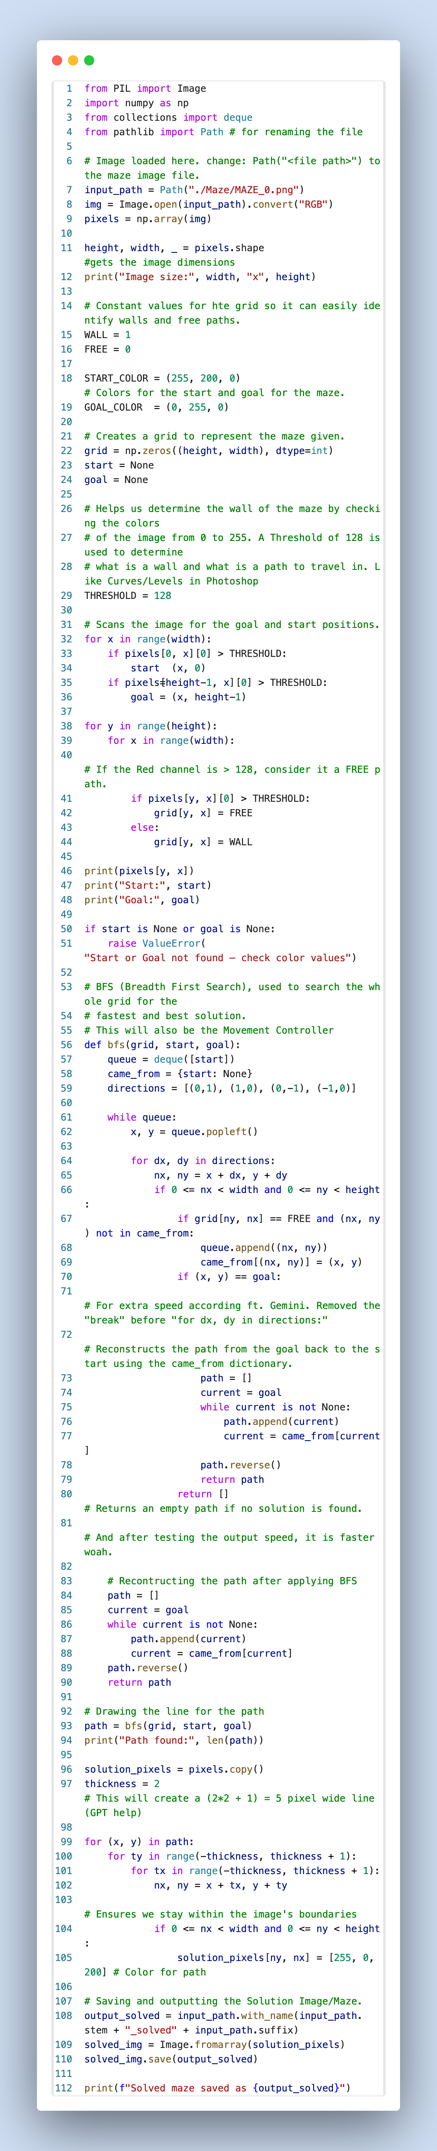

Slide 4
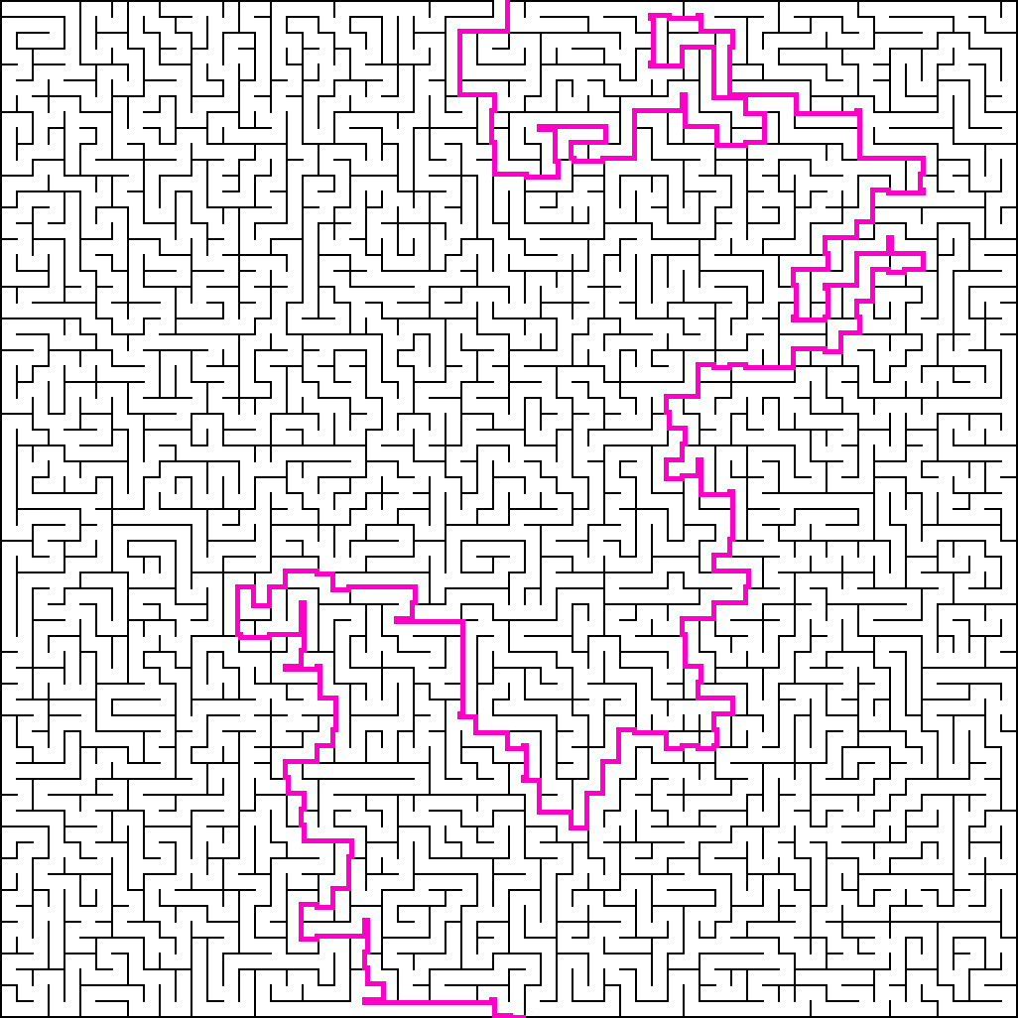
Solved Maze

